Slide 1
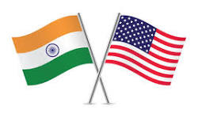
Comparative Analysis of US and Indian Healthcare Systems
BIA GROUP 4:
Rahul Mishra Anand Gupta Ryan Mack
Guided By: Prof. William Oliver

Slide 2

Thesis
Purpose: Thorough comparative analysis between US private healthcare and Indian public healthcare
Objectives: Evaluate efficiency and effectiveness via metrics like healthcare quality, health indicators, demography, expenditures, and service accessibility.
Scope: Primarily comparing the healthcare systems of the USA and India, with occasional references to the global context.

Slide 3
Conclusion
Through the application of sophisticated statistical methods and thorough data analysis, the research provides nuanced insights into the comparative efficiency and effectiveness of the healthcare systems in the United States, India and the World. The selected charts offer a comprehensive visual representation of key indicators, allowing for a holistic understanding of the strengths and weaknesses of each system. The findings aim to contribute substantially to the ongoing discourse surrounding healthcare governance, providing valuable information for policymakers, healthcare professionals, and researchers. The challenges faced during the data cleansing process highlight the importance of adaptability and perseverance in handling real-world data scenarios. Overall, the project stands as a robust exploration of the complex dynamics in healthcare systems, shedding light on potential areas for improvement and future research.

Slide 4

Key Takeaways from Comparative Analysis of Healthcare Systems
INDIA
Public-Private Balance:
India's healthcare system leans predominantly towards public services, with a significant focus on government-funded initiatives. However, challenges in accessibility and quality persist, especially in rural areas.
Maternal and Child Health:
Maternal and child health indicators in India demonstrate disparities, indicating the need for targeted interventions and policy enhancements to ensure the well-being of mothers and children.
Resource Challenges:
Despite progress, resource constraints, including a shortage of healthcare professionals and infrastructure, remain significant hurdles, impacting the overall effectiveness of the healthcare system.
Preventive Healthcare:
Opportunities exist for improving preventive healthcare practices, as highlighted by variations in immunization rates. Increased emphasis on awareness and accessibility can contribute to enhanced public health.

Slide 5

United States
Privatized Dominance:
The United States exhibits a predominantly privatized healthcare system, emphasizing individual insurance and private healthcare providers. This results in a high level of healthcare expenditure, often impacting accessibility for certain demographics.
Advanced Healthcare Infrastructure:
The U.S. boasts advanced healthcare infrastructure, reflected in high-tech medical facilities, specialized care, and a well-developed pharmaceutical industry. However, challenges such as high costs and unequal access persist.
Healthcare Expenditure Composition:
The composition of healthcare expenditure in the U.S., with a significant share contributed by private sources, underscores the importance of balancing public and private participation for sustainable healthcare systems.
Life Expectancy and Chronic Conditions:
While life expectancy in the U.S. is relatively high, the prevalence of chronic conditions poses challenges. Addressing these conditions requires a comprehensive and inclusive healthcare strategy.

Slide 6

Global Context:
Diversity of Healthcare Systems:
The global context reveals a diverse range of healthcare systems, each with its strengths and weaknesses. Variations in healthcare governance, funding models, and cultural factors contribute to this diversity.
Role of International Organizations:
International organizations like the World Health Organization (WHO) play a pivotal role in shaping global health policies, coordinating efforts, and addressing cross-border health challenges.
Universal Health Coverage (UHC):
The pursuit of Universal Health Coverage is a shared global goal, with efforts focused on ensuring that all individuals can access essential health services without financial hardship.
Global Health Challenges:
Common global health challenges, including infectious disease outbreaks, maternal and child health disparities, and the burden of non-communicable diseases, highlight the interconnected nature of health on a global scale.

Slide 7
Cross-Cutting Themes:
Data-Driven Decision-Making:
Data analysis and visualization tools play a crucial role in understanding healthcare systems, identifying areas for improvement, and informing evidence-based decision-making at both national and global levels.
Socio-Economic Factors:
Socio-economic factors, such as poverty, influence healthcare outcomes globally. Addressing these determinants is integral to achieving equitable and effective healthcare systems.
Adaptability and Innovation:
The ability to adapt healthcare systems to evolving challenges and embrace innovative solutions is paramount. Lessons learned from different systems can inspire innovative approaches to common issues.
Overall, the comparative analysis underscores the complexity of healthcare systems, emphasizing the need for tailored strategies that align with each country's socio-economic context. The global perspective highlights the importance of collaboration, shared learning, and a commitment to achieving universal health goals.

Slide 8
Contributions of Each Visualization
Population Comparison:
A visual overview of total populations facilitates a nuanced understanding of demographic differences between the United States and India.
Life Expectancy Trends:
The visualization of trends over time provides insights into the evolving life expectancy in both countries and potential influencing factors.
Maternal and Child Health:
Disparities in maternal and child health indicators are highlighted, offering actionable insights for targeted interventions and policy considerations.
Health Expenditure Analysis:
The display of health expenditure composition aids in understanding the balance between public and private contributions and their implications for overall healthcare.
Hospital Beds Availability:
A clear and comparative view of hospital bed availability is presented, a critical factor in assessing healthcare infrastructure.

Slide 9
Immunization Rates:
A comparison of immunization rates offers insights into preventive healthcare practices and identifies potential areas for improvement.
Health Workforce Density:
Variations in healthcare workforce density are highlighted, indicating potential areas for strategic workforce planning and development.
Poverty and Healthcare Expenditure per Capita:
The visualization of the complex relationship between poverty, out-of-pocket healthcare expenditure, and overall health expenditure provides a nuanced understanding of socio-economic factors.

Slide 10
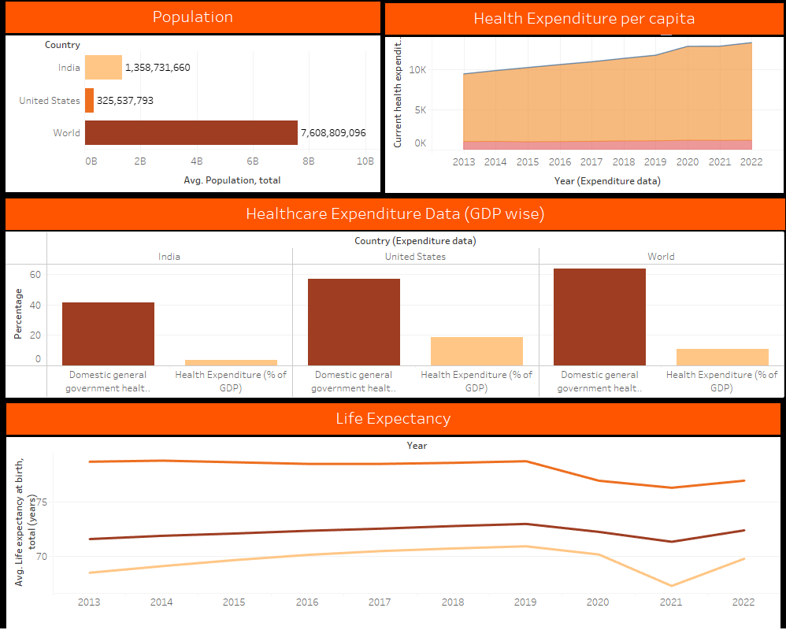
Dashboard 1

Slide 11
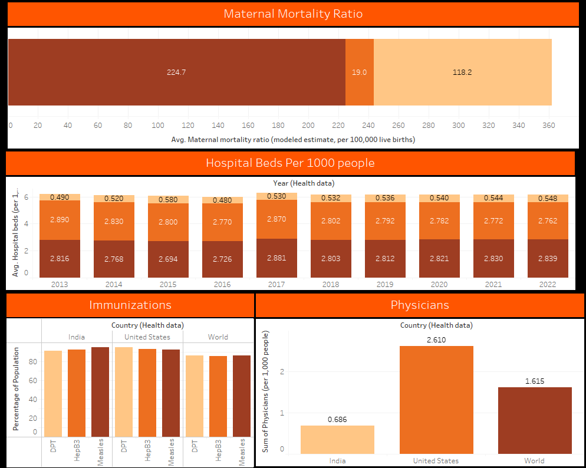
Dashboard 2

Slide 12
Data Source:
S.No. | URL
1 | https://blog.pinacaindia.com/healthcare-data-and-privacy-pinaca-india/
2 | https://www.un.org/sustainabledevelopment/health/
3 | https://www.ibef.org/industry/healthcare-india/infographic
4 | https://www.indiastat.com/
5 | https://www.investindia.gov.in/sector/healthcare
6 | https://phrma.org/resource-center/chart-packs
7 | https://www.oecd.org/india/
8 | https://databank.worldbank.org/reports.aspx?source=2&country=IND
9 | Healthcare in the United States - Wikipedia
10 | India (who.int)
11 | OECD Statistics

